Slide 1
Growth Mindset Impacts on Teaching and Learning
Presented by David Swart
Rescue Union School District
September 6, 2016
Based on the work of Dr. Carol Dweck
Stanford University

Slide 2
Dr. Carol Dweck, Ph.D Stanford University
Original work in 2006
Book entitled, “Mindset - the New Psychology of Success” (Ballantine Books, Amazon)
Work bridges Developmental, Social and Personality Psychology
Based on research on brain “plasticity”
Huge Implications for Teaching and Learning,
Parenting, Business, Sports, Music, even Personal Relationships!

Slide 3
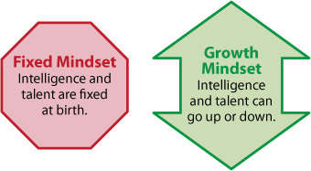
Growth Mindset
Notes:
1 m

Slide 4
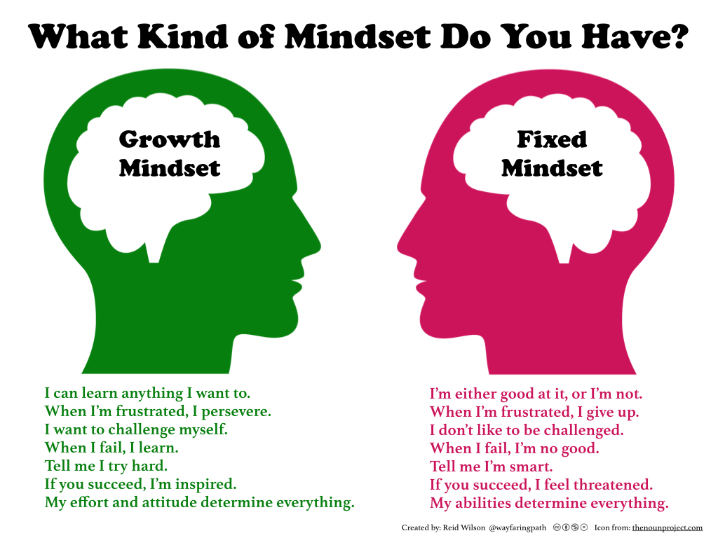
Notes:
0

Slide 5
Mindset Quiz (5-7 minutes)
Please place a check in the box that identifies the extent to which you agree or disagree with the statement.
After completing the quiz, circle the number in the box that matches each of your answers, then total each column and get a grand total.

Slide 6
Mindset Quiz Results
45 – 60 Points = Strong Growth Minds
34 – 44 Points = Growth Mindset with some Fixed ideas
21 – 33 Points = Fixed Mindset with some Growth ideas
0 – 20 Points = Strong Fixed Mindset

Slide 7
Think, Pair, Share
Impacts of the Classroom
Now that you have seen the questions, which mindset do you think you are? (Strong Growth, Growth with some Fixed, Fixed with some growth, or Strong Fixed)
Journal #2: Now that you have scored it, do you think this is accurate? Where in your life can you recognize fixed mindsets? Where are you growth-minded?
What effect does “teacher expectation” have on student learning? (Marzano)
How do our own beliefs (fixed vs. growth mindset) affect how we teach our students?
If we taught all students to have a growth mindset, what impact would it have on how students approach their own individual learning?
How can a growth mindset increase rigor?

Slide 8
How Can a Growth Mindset Increase Rigor?
Notes:
1 m

Slide 9
Video #1
Carol Dweck:
“How to Help Every Child Fulfill Their Potential”

Slide 10
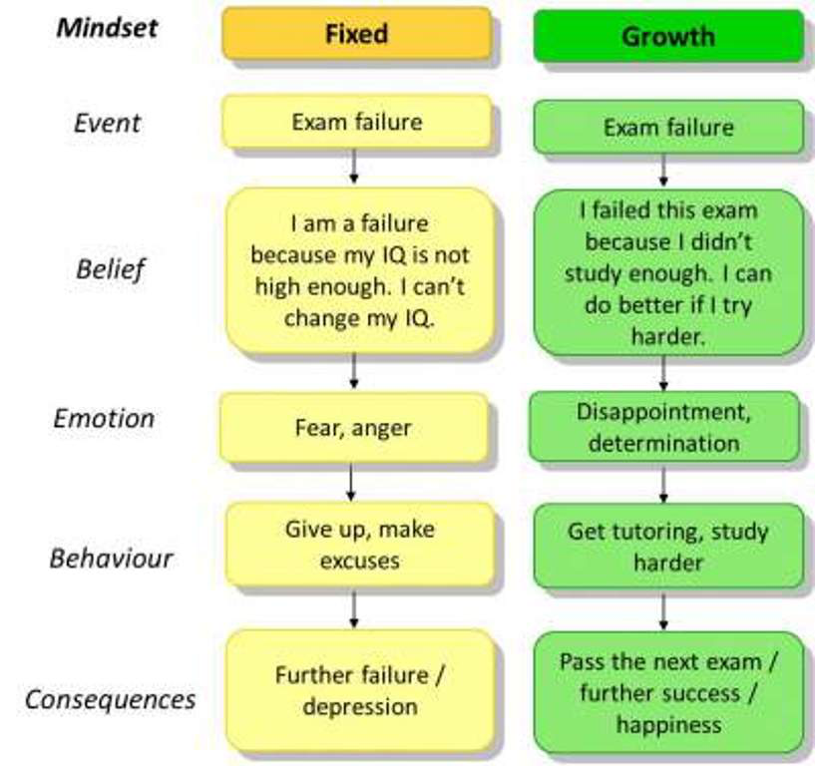
Notes:
0

Slide 11
Dweck and her colleagues offered four-year-olds a choice: They could either redo an easy jigsaw puzzle, or try a harder one.
Even these young children conformed to the characteristics of one of the two mindsets — those with “fixed” mentality stayed on the safe side, choosing the easier puzzles that would affirm their existing ability, articulating to the researchers their belief that smart kids don’t make mistakes; those with the “growth” mindset thought it an odd choice to begin with, perplexed why anyone would want to do the same puzzle over and over if they aren’t learning anything new.
In other words, the fixed-mindset kids wanted to make sure they succeeded in order to seem smart, whereas the growth-mindset ones wanted to stretch themselves, for their definition of success was about becoming smarter.

Slide 12
Video #2
Carol Dweck:
“A Study on Praise and Mindset”
The effects of praise on growth mindset/effort vs. intelligence and ability

Slide 13
Two Mindsets Ramifications for Learning
Challenges
Obstacles
Effort
Criticism
Success of Others

Slide 14
Effects of Growth Mindset in the Classroom
Beliefs effect learning outcomes (learning is viewed as the path to mastery)
Effort (not yet)
Questioning
Feedback
Mistakes
Feedback
Thinking (metacognition)
Persistence
Less fear of negative consequences

Slide 15
Conclusion: Growth Mindset
20 years of research indicates that the view that you adopt for yourself profoundly affects the way you lead your life
Believing that your basic qualities (and those of others) are carved in stone (the fixed mindset) creates an urgency to prove yourself over and over
Growth Mindset moves us from the belief in fixed attributes and in recognizing and praising “intelligence” toward a growth mindset that recognizes the importance of:
*Strategies *Effort
*Focus *Persistence (“not yet”)
Growth Mindset changes how we perceive “failure”
Cultivated by deliberate practice and specific vocabulary

Slide 16
Implications for the Classroom
Performance Goals vs. Learning Goals
Performance Goals = About measuring ability (students may condemn themselves)
Learning Goals = About mastering new things
Performance goals contribute to “Entity Theory”
Growth goals – Students see both themselves and learning in a different way!
(This changes how we plan, teach and assess.)

Slide 17
Even Greater Implications
Growth Mindset creates an enjoyment around learning
Fixed Mindset – Can foster dishonesty (40% of “smart kids” were dishonest about their scores because we told them they were smart)
Implications for relationships – myths about “true love”, “living happily ever after”, (the ideal vs. growth mindset – improving communication and avoiding assigning blame)
Growth mindset can create a voracious appetite for learning!!!

Slide 18
Basic Components – “Developing Growth Mindsets in the Classroom” by Mike Gershon (2016)
Getting the Language right
Changing how students perceive mistakes
Targeting student effort
Giving great feedback
Thinking about thinking (metacognition)
Creating a challenging culture
Focusing on process
Engaging parents with growth mindset

Slide 19
Impacts of Teaching and Learning
Shifts in thinking in how to meet the needs of all students (differentiation) in the classroom
Shifts in programs such as GATE (from a small subgroup to how we better serve all students)
Differentiation is critical but there are many myths around differentiation such as:
#1 “Differentiation means I have to plan something different for every student”
#2 “I differentiate by grouping students by reading ability and giving them leveled readings.”
#3 “I can differentiate effectively using one data point.”
#4 “Differentiation is easy, just give the high students more and the low students less.”
#5 “I don’t need to change anything about my instructional practices to effectively differentiate.”

Slide 20
Thank you! Enjoy your day.
Resources for this presentation:
Carol Dweck: “Mindset: the New Psychology of Success (2006, Random House)
Mike Gershon: “How to Develop Growth Mindsets in the Classroom (2016) – 60 strategies
Mary Cay Ricci: “Mindsets in the Classroom, Building a Culture of Success and Student Achievement in Schools (2013, Prufrock Press)

